Slide 1
MSI Circuits

Slide 2
Useful MSI circuits
Four common and useful MSI circuits are:
Decoder
Demultiplexer
Encoder
Multiplexer
Block-level outlines of MSI circuits:
decoder
encoder
code
entity
entity
code
mux
data
data
demux
output
input
select
select

Slide 3
Decoders
Convert binary information from n input lines to (max. of) 2^{n} output lines.
Known as n-to-m-line decoder, or simply n:m or n×m decoder (m ≤ 2^{n}).
May be used to generate 2^{n} (or fewer) minterms of n input variables.

Slide 4
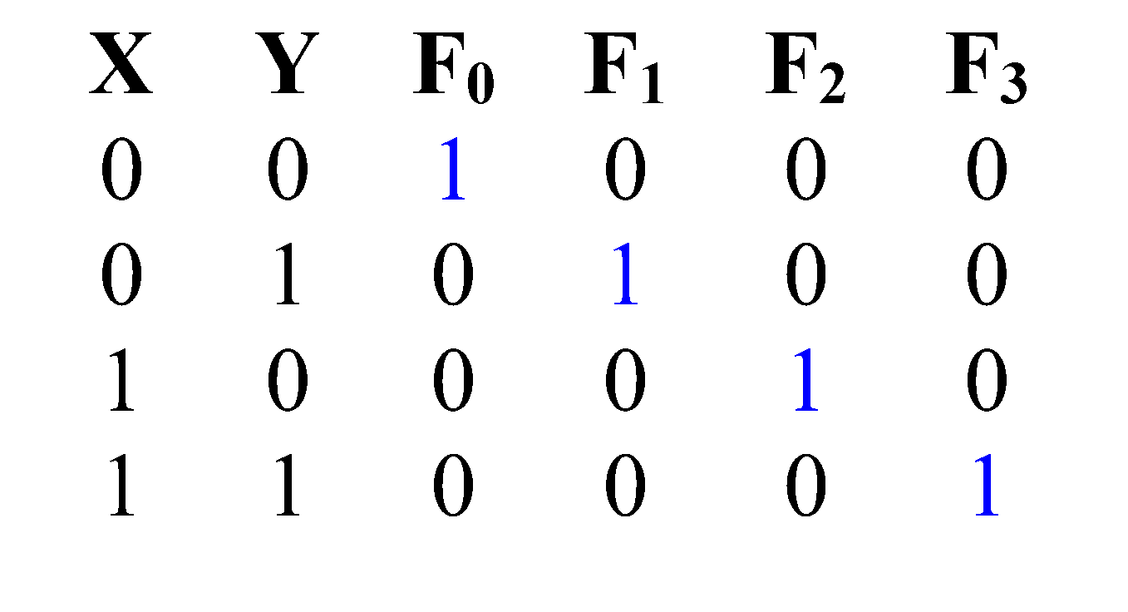
Decoders
Example: if codes 00, 01, 10, 11 are used to identify four light bulbs, we may use a 2-bit decoder:
2x4
Dec
F₀ F₁ F₂ F₃
Bulb 0
Bulb 1
Bulb 2
Bulb 3
2-bit code
X
Y
This is a 2×4 decoder which selects an output line based on the 2-bit code supplied.
Truth table:

Slide 5
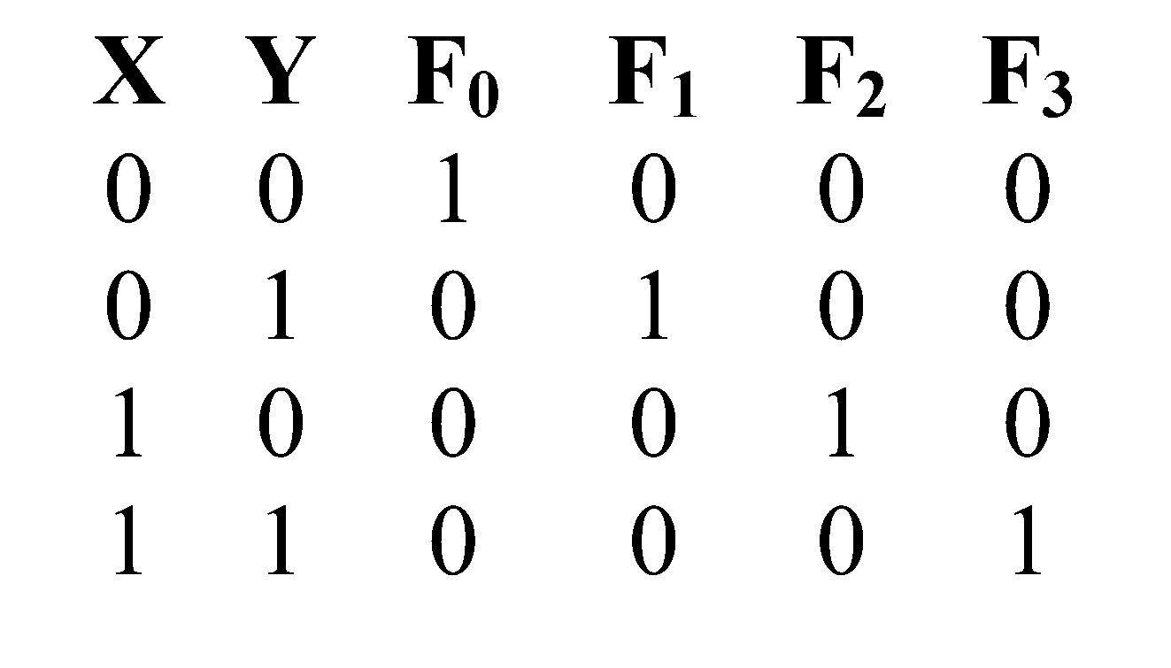
Decoders
From truth table, circuit for 2×4 decoder is:
Note: Each output is a 2-variable minterm (X'Y', X'Y, XY' or XY)
F₀ = X'Y'
F₁ = X'Y
F₂ = XY'
F₃ = XY
X
Y

Slide 6
Decoders
Design a 3×8 decoder by yourself.

Slide 7
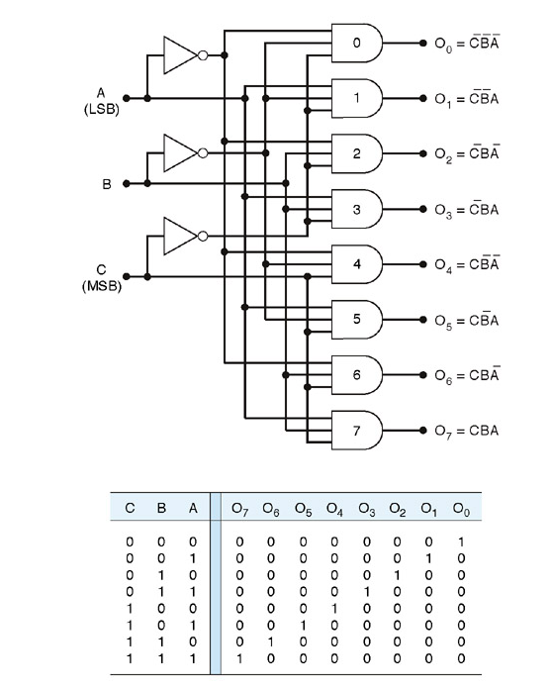
Solution

Slide 8
Decoders
In general, for an n-bit code, a decoder could select up to 2^{n} lines:
n-bit
code
n to 2^{n}
decoder
up to 2^{n}
output lines
:
:
As n input generates 2^n output, which reminds us of canonical SOP, thus a decoder can be used to generate any function

Slide 9
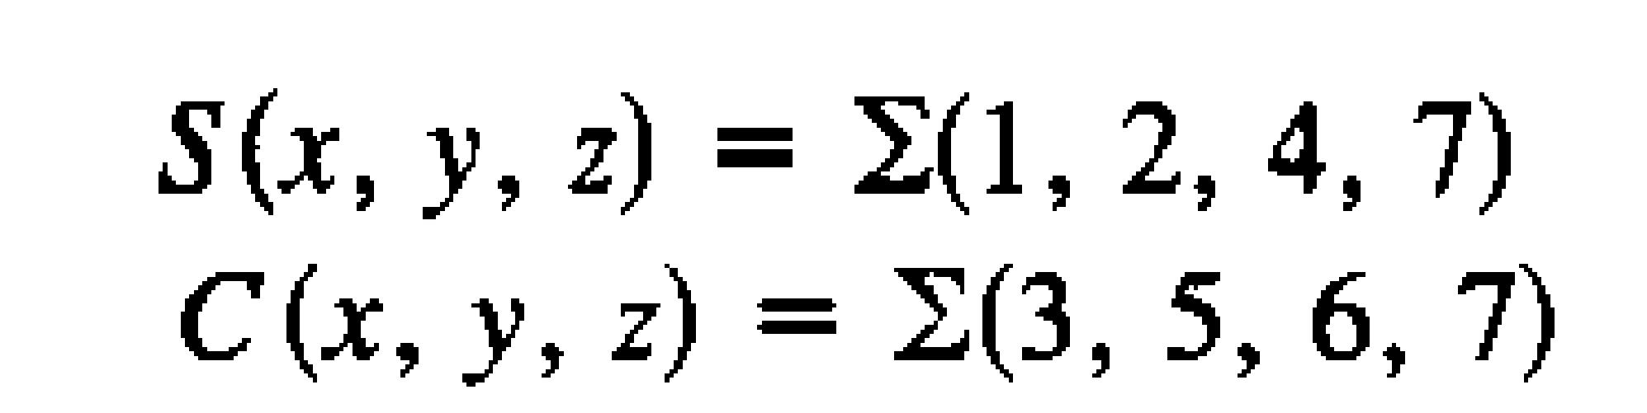
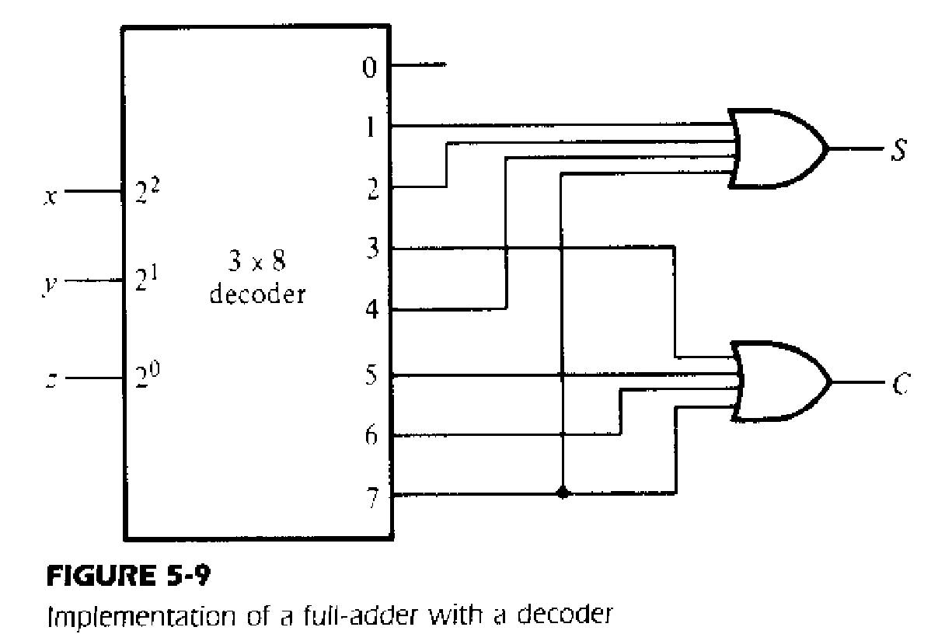
Application of Decoder
Example 1: Full adder circuit with decoder (3 x 8 decoder)

Slide 10
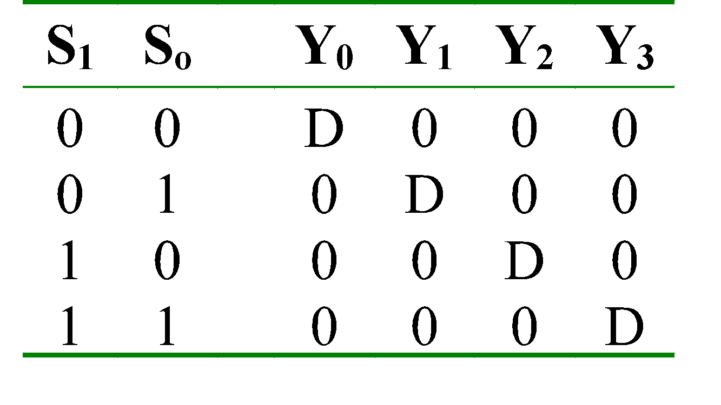
Demultiplexer
Given an input line and a set of selection lines, the demultiplexer will direct data from input to a selected output line.
An example of a 1-to-4 demultiplexer:
Outputs
Y₀ = D.S₁'.S₀'
Y₁ = D.S₁'.S₀
Data D
demux
Y₂ = D.S₁.S₀'
Y₃ = D.S₁.S₀
S₁ S₀
select

Slide 11
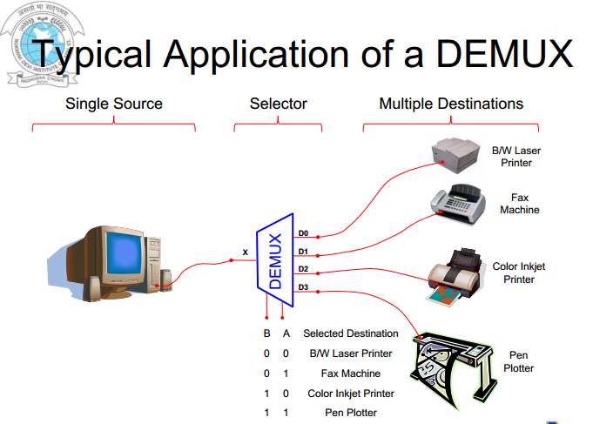

Slide 12
Demultiplexer
The demultiplexer is actually identical to a decoder with enable. A decoder with an enable input can function as a demultiplexer (or demux) Decoder + enable= demultiplexer
The selection of a specific output line is controlled by the bit values of ‘n’-selection lines.
Y₀ = D.S₁'.S₀'
2x4 Decoder
S₁
S₀
Y₁ = D.S₁'.S₀
data
demux
output
Y₂ = D.S₁.S₀'
E
Y₃ = D.S₁.S₀
select
D

Slide 13
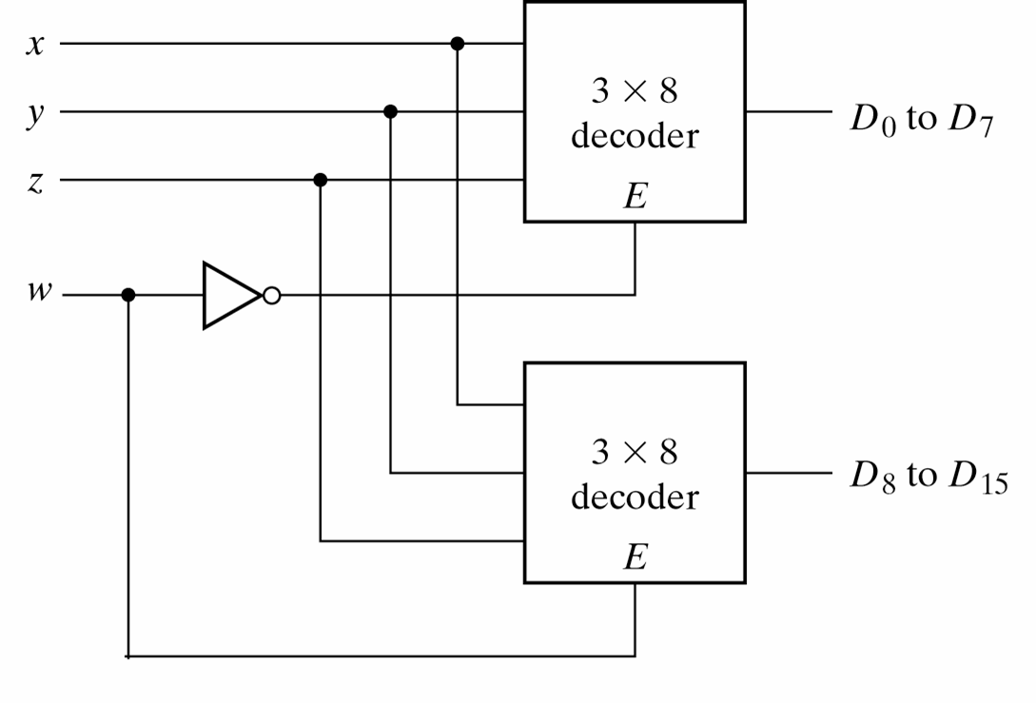
4-line-to-16 line Decoder constructed with two 3-line-to-8 line decoders with enables

Slide 14
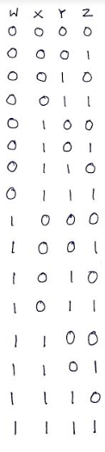
4-line-to-16 line Decoder constructed with two 3-line-to-8 line decoders with enables
When w=0, the top decoder is enabled and the other is disabled. The bottom decoder outputs are all 0’s , and the top eight outputs generate min-terms 0000 to 0111.
When w=1, the enable conditions are reversed. The bottom decoder outputs generate min-terms 1000 to 1111, while the outputs of the top decoder are all 0’s.

Slide 15
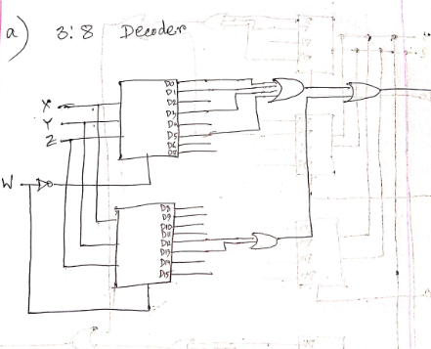
F(a,b,c,d)=∑(0,1,3,5,12,13)
Implement the above boolean function using
3:8 Decoder(s).
2:4 Decoder(s).

Slide 16
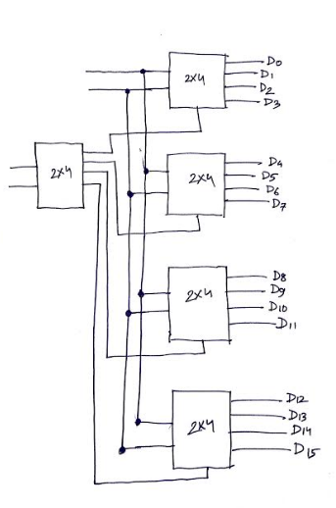
F(a,b,c,d)=∑(0,1,3,5,12,13)
Implement the above boolean function using
3:8 Decoder(s).
2:4 Decoder(s).
You have to connect D0,D1,D3,D5,D12 & D13 with OR Gate

Slide 17
Multiplexer
A multiplexer is a device which has
(i) a number of input lines
(ii) a number of selection lines
(iii) one output line
A Multiplexer steers one of 2^{n} inputs to a single output line, using n selection lines. Also known as a data selector.
2^{n}:1
Multiplexer
inputs
output
:
...
select

Slide 18
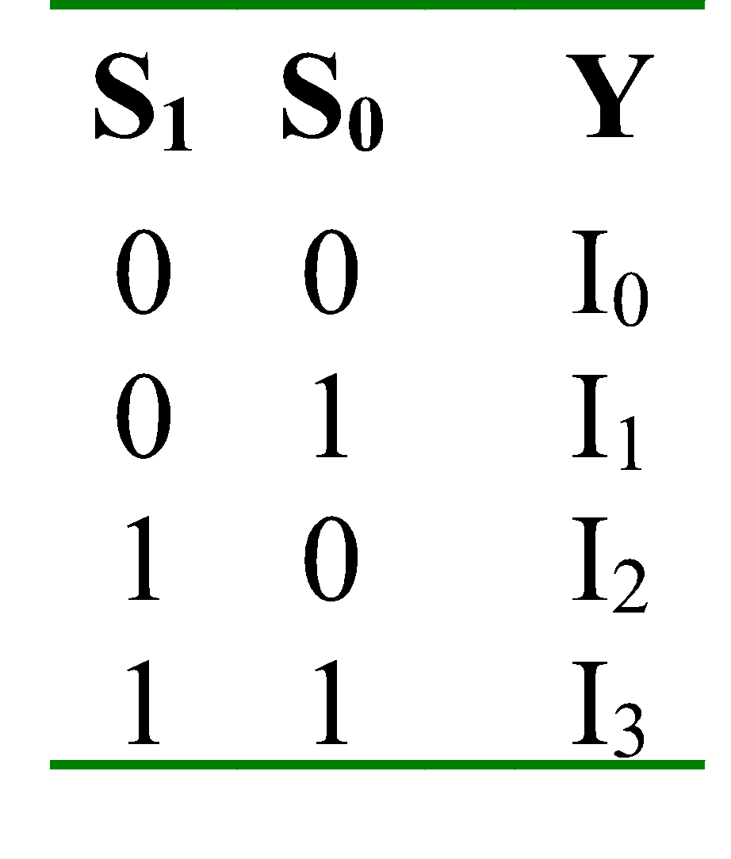
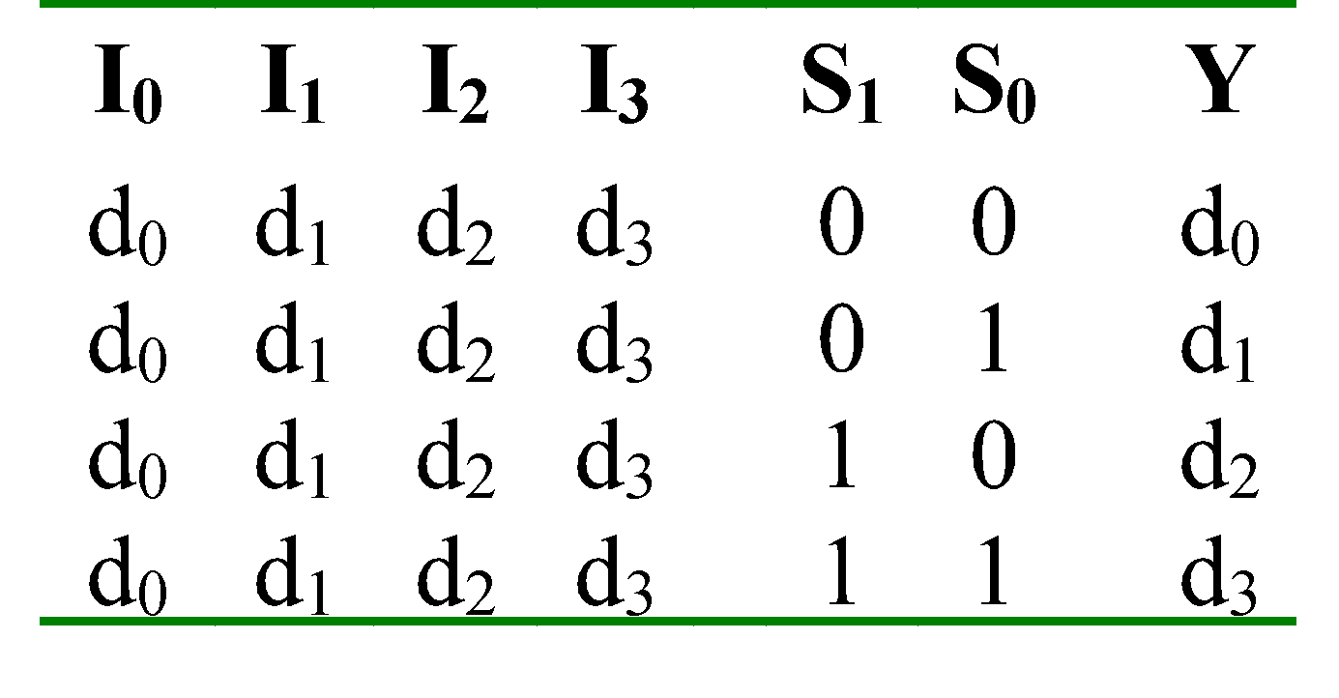
Multiplexer
Truth table for a 4-to-1 multiplexer:
Inputs
Inputs
I₀
0
1
2
3
I₀
I₁
4:1
MUX
I₁
I₂
Y
Output
I₂
mux
Y
I₃
I₃
S₁ S₀
S₁ S₀
select
select

Slide 19
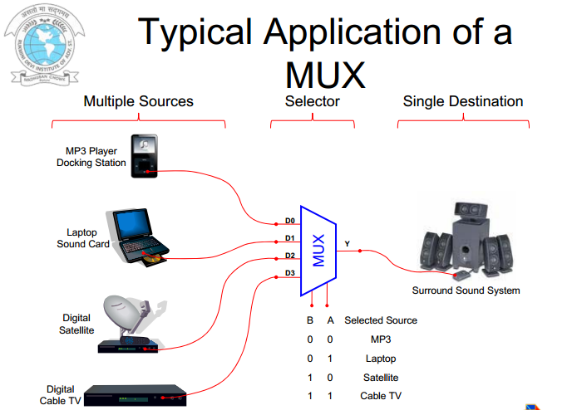

Slide 20
Multiplexer
Output of multiplexer is
“sum of the (product of data lines and selection lines)”
Often known as Data selector as it selects one of the many inputs and steers the binary information to the output line.
Example: the output of a 4-to-1 multiplexer is:
Y = I₀.(S₁’.S₀') + I₁.(S₁’.S₀) + I₂.(S₁.S₀') + I₃.(S₁.S₀)

Slide 21
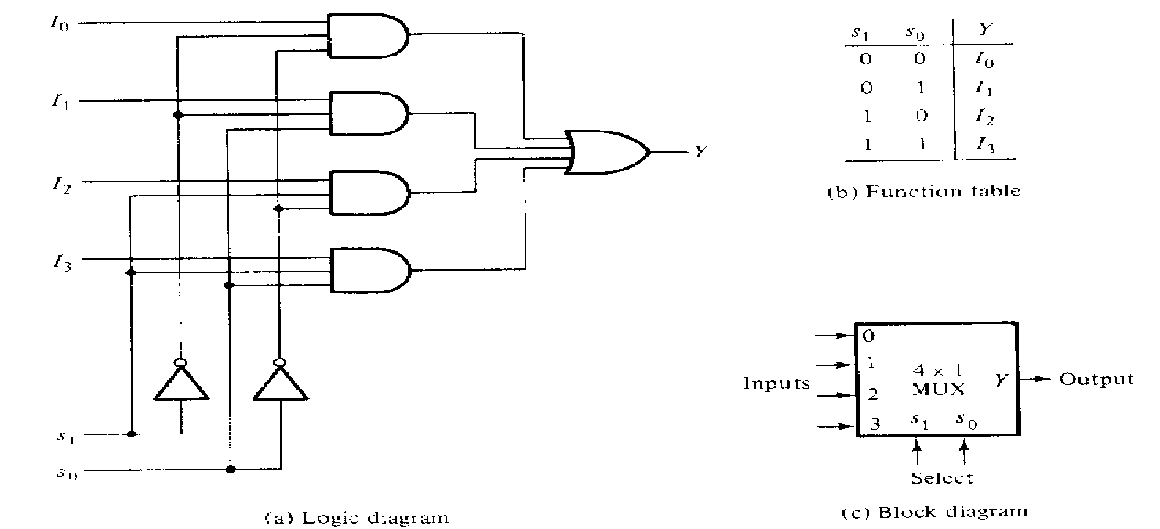
Try it yourself
Draw the internal circuit diagram (logic diagram) of a 4-to-1 multiplexer.
Solution
Y = I₀.(S₁’.S₀') + I₁.(S₁’.S₀) + I₂.(S₁.S₀') + I₃.(S₁.S₀)

Slide 22
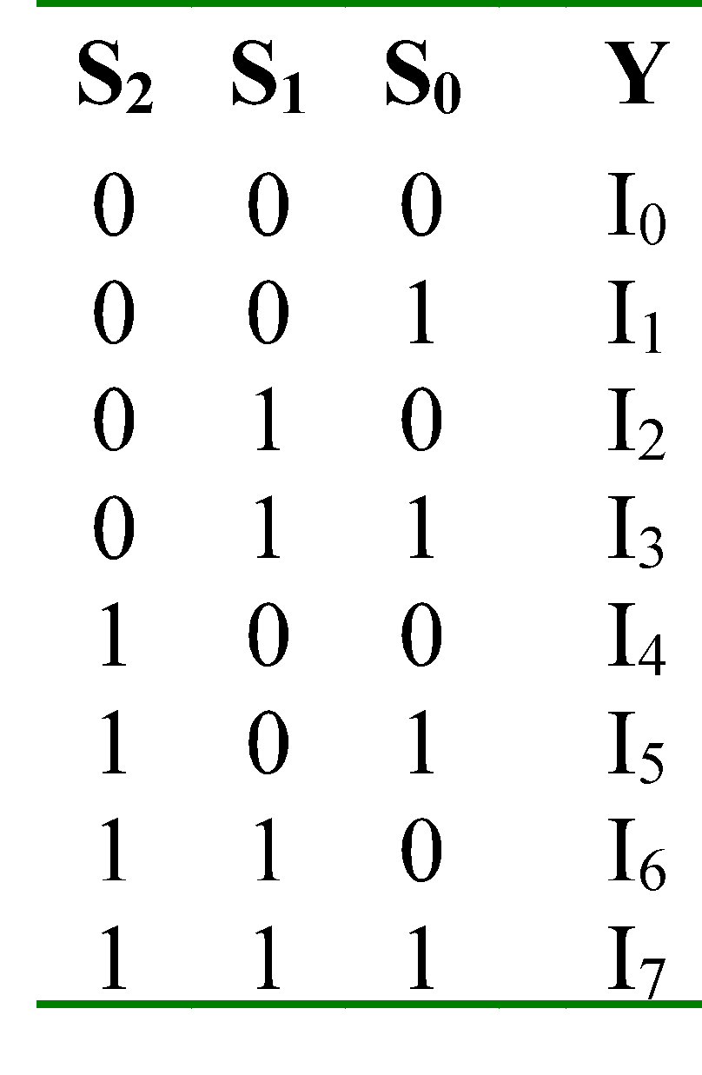
Larger Multiplexers
Larger multiplexers can be constructed from smaller ones.
An 8-to-1 multiplexer can be constructed from smaller multiplexers like this (from two 4x1 and one 2x1):

Slide 23
Larger Multiplexers
Larger multiplexers can be constructed from smaller ones.
An 8-to-1 multiplexer can be constructed from smaller multiplexers like this (from two 4x1 and one 2x1):
I₀
I₁
I₂
I₃
When
S₂S₁S₀ = 000
4:1 MUX
I₀
2:1 MUX
I₀
S₁ S₀
Y
I₄
I₅
I₆
I₇
4:1 MUX
I₄
S₂
S₁ S₀

Slide 24
Larger Multiplexers
Another implementation of an 8-to-1 multiplexer using smaller multiplexers (four 2x1 and one 4x1):

Slide 25
Larger Multiplexers
Another implementation of an 8-to-1 multiplexer using smaller multiplexers (four 2x1 and one 4x1):
When
S₂S₁S₀ = 000
I₀
I₁
2:1 MUX
I₀
I₂
I₃
2:1 MUX
I₂
S₀
4:1 MUX
I₀
S₀
Y
I₄
I₅
2:1 MUX
I₄
S₂ S₁
S₀
I₆
I₇
2:1 MUX
I₆
S₀
Q: Can we use only 2:1 multiplexers?

Slide 26
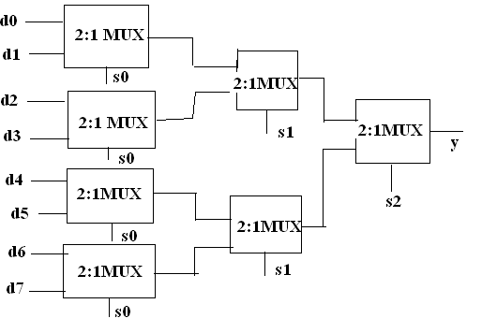
Larger Multiplexers
Q: Can we use only 2:1 multiplexers?

Slide 27
Try it yourself: Larger Multiplexers
A 16-to-1 multiplexer can be constructed from only 4-to-1 multiplexers:

Slide 28
Encoder
Encoder is a digital function that produces a reverse operation of a decoder!
It has 2^{n} input lines and n output lines

Slide 29
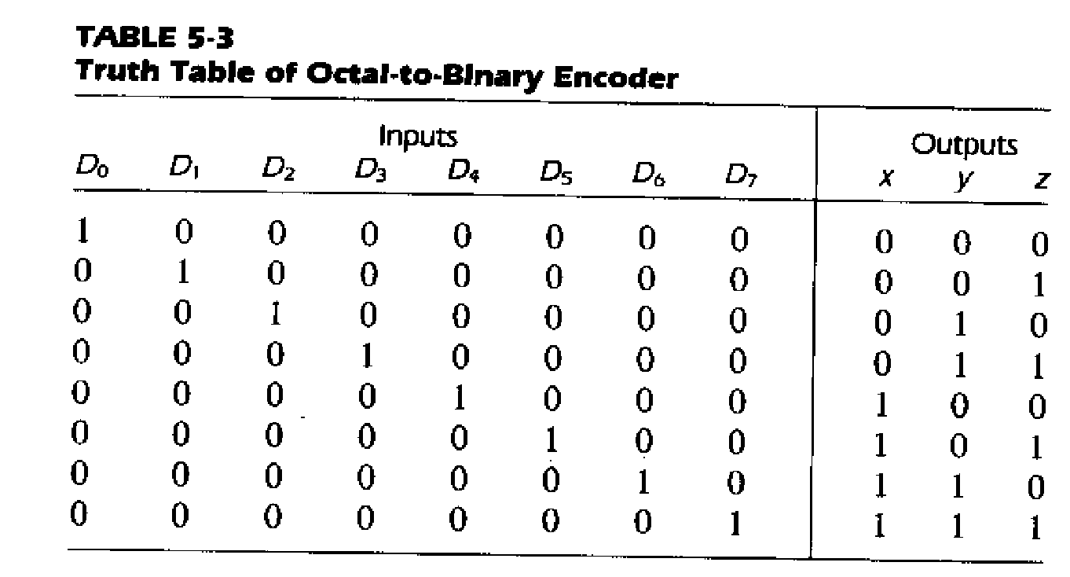
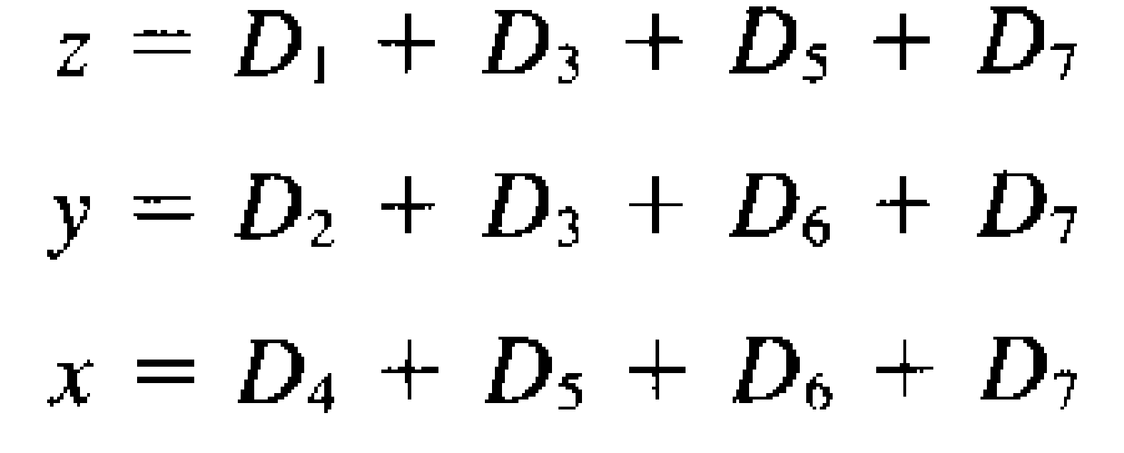
Example: Octal-binary encoder

Slide 30
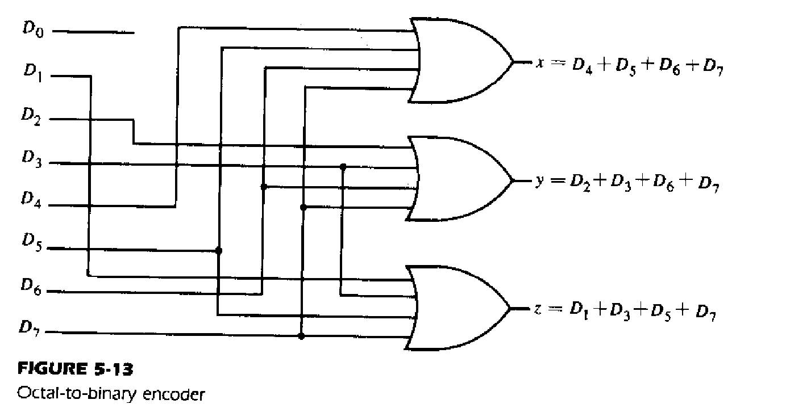
Example: Octal-binary encoder
There are 8 input variables so there will 2⁸ input combination, amongst which in Octal-binary encoder only 8 are useful

Slide 31
Example: Priority Encoder
Design a priority encoder, which will allow more than one input to exist and encodes only the highest priority input line. For example, 8x3 encoder in a if user give D2 and D7 together, it will allow data of D7 to pass.

Slide 32
Priority Encoder
Accepts multiple values and encodes them
Works when more than one input is active
Consists of:
Inputs (2^{n})
Outputs
when more than one output is active, sets output to correspond to highest input
V (indicates whether any of the inputs are active). This helps to show the output when all inputs are 0s
Selectors / Enable
Notes:
‹#›

Slide 33
D3 | D2 | D1 | D0 | A1 | A0 | V
0 | 0 | 0 | 0 | x | X | 0
0 | 0 | 0 | 1 | 0 | 0 | 1
0 | 0 | 1 | 0 | 0 | 1 | 1
0 | 0 | 1 | 1 | 0 | 1 | 1
0 | 1 | 0 | 0 | 1 | 0 | 1
0 | 1 | 0 | 1 | 1 | 0 | 1
0 | 1 | 1 | 0 | 1 | 0 | 1
0 | 1 | 1 | 1 | 1 | 0 | 1
1 | 0 | 0 | 0 | 1 | 1 | 1
1 | 0 | 0 | 1 | 1 | 1 | 1
1 | 0 | 1 | 0 | 1 | 1 | 1
1 | 0 | 1 | 1 | 1 | 1 | 1
1 | 1 | 0 | 0 | 1 | 1 | 1
1 | 1 | 0 | 1 | 1 | 1 | 1
1 | 1 | 1 | 0 | 1 | 1 | 1
1 | 1 | 1 | 1 | 1 | 1 | 1
Note: V is not really an output, just shows whether there is an active input or not.
Note: Amongst all 3 input, D2 is highest so output reflects the binary value of 2

Slide 34
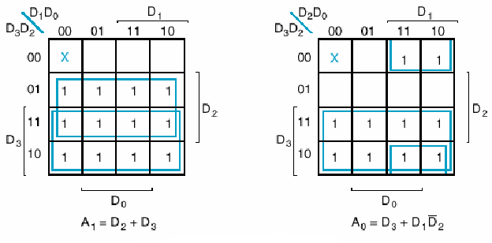
Priority Encoder

Slide 35
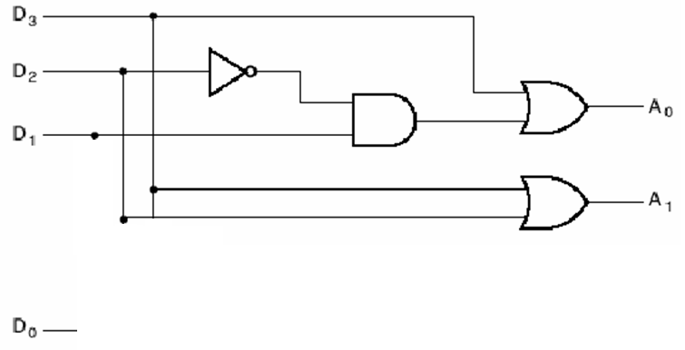
Priority Encoder

Slide 36
Boolean Function implementation using MSI

Slide 37
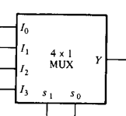
Try it yourself
Using 4:1 MUX design
AND gate
OR gate
NOT gate
AND
OR
GND
GND
+5v
+5v
NOT
+5v
X
X
GND

Slide 38
Try it yourself
a)Built the following function using 8x1 Mux.
F=∑(0,4,5) b)Design same thing with 3x8 decoder
c) Try designing it with single 4x1 Mux

Slide 39
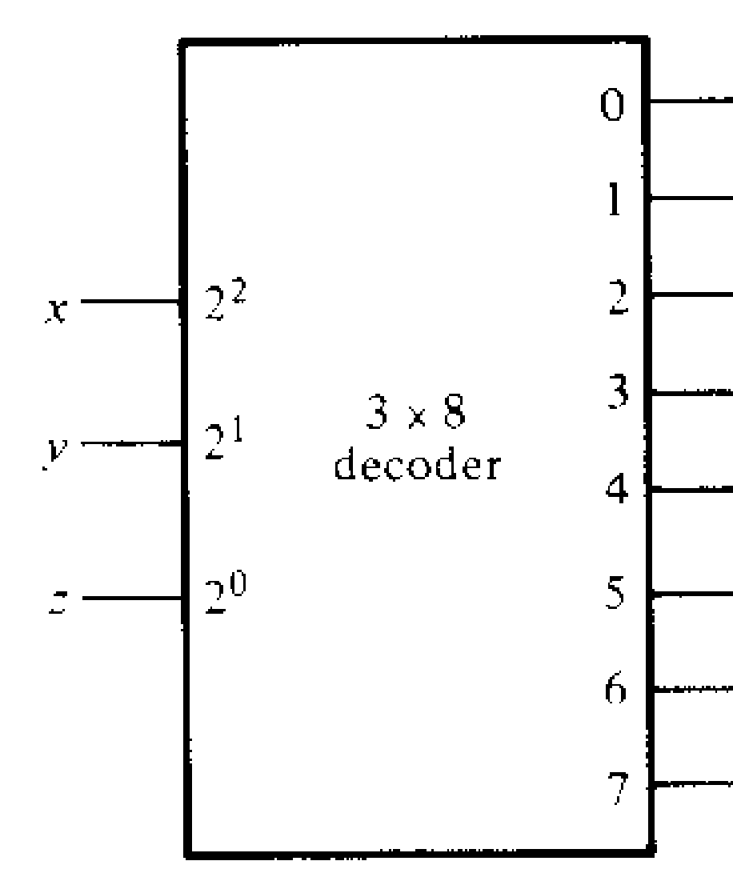
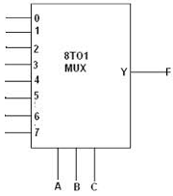

Solution
F=∑(0,4,5)
a)
b)
5V

Slide 40
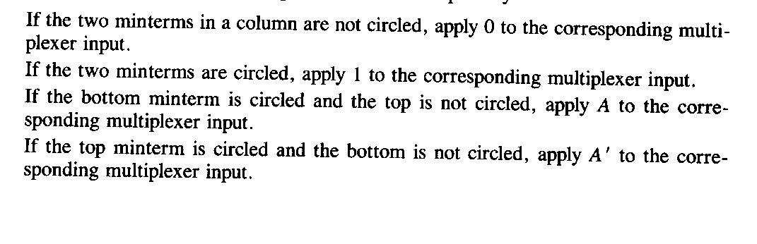
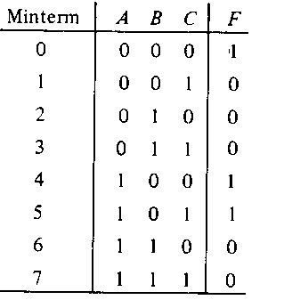
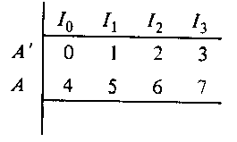
Rules: for using smaller mux to build larger equation
Answer: Part ( c )
1 A
0
0
1 A 0 0
B C

Slide 41

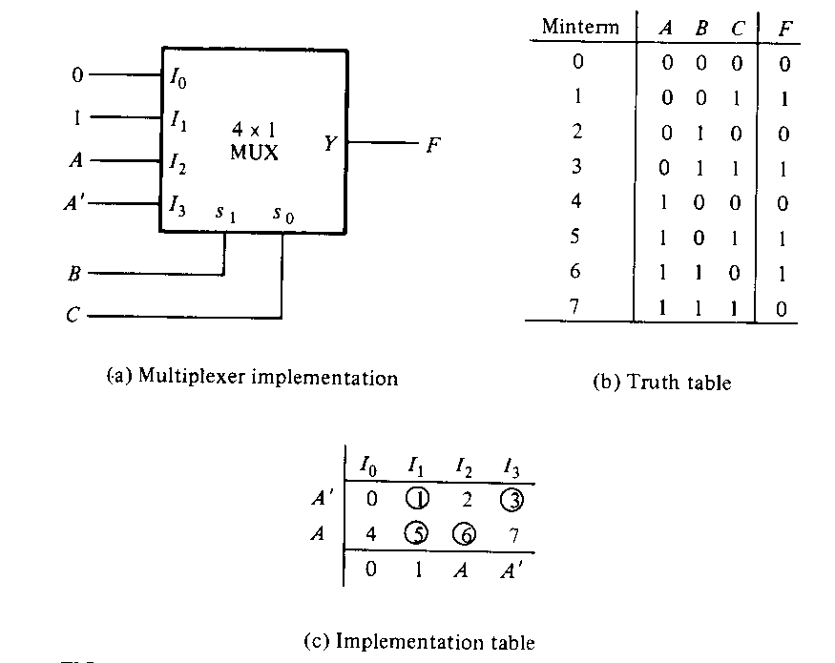
Built the following function using 4x1 Mux

Slide 42

Try it yourself
Implement the below function using a 8x1 Mux.
Implement the below function using a 4x16 decoder and OR gates

Slide 43
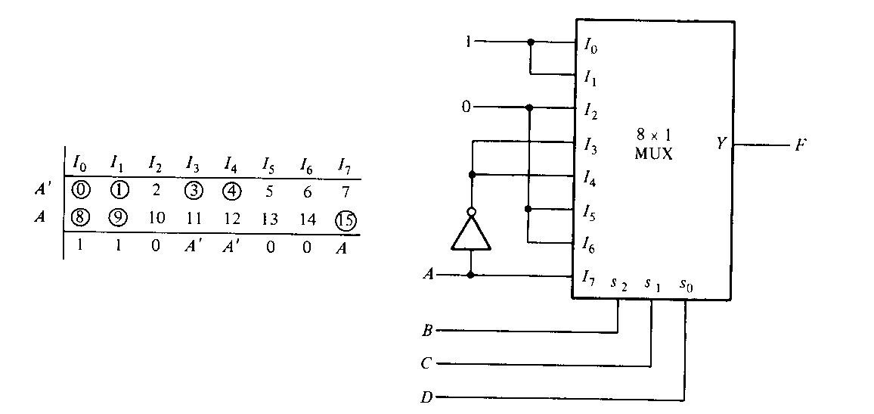
Solution
a)

Slide 44
Home-task: Try it yourself
Using 2:1 MUX design
AND gate
OR gate
NOT gate
Solution: Try YOUTUBE

Slide 45
Note:
Both mux and decoder can be used to design combinational circuit.
Decoder are mostly used to decoding binary information and mux are mostly used to select path between multiple sources and a single destination.

Slide 46
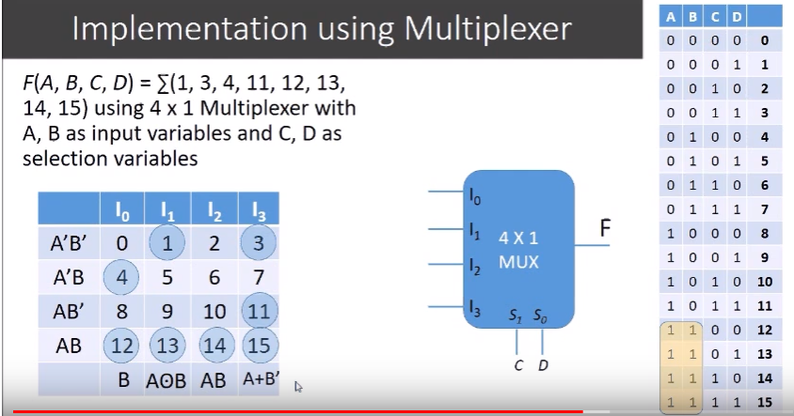
4 variables with 4x1 Mux
https://www.youtube.com/watch?v=c8lhlAX2JMk

Slide 47
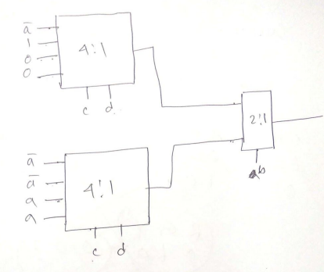
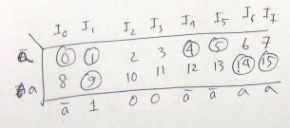
F(a,b,c,d)=∑(0,1,4,5,9,14,15)
Implement the above boolean function using 4:1 MUX(s) and 2:1 MUX(s).

Slide 48
Combining MSI to build Combinational Design Circuit

Slide 49
Exercise time!
Design a BCD to Excess 3 code converter using ‘4x16’ decoder and ‘16x4’ encoder

Slide 50
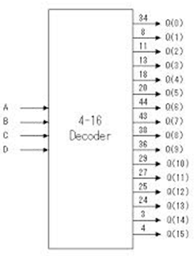
Solution
16:4 encoder

Slide 51
Try it yourself
Design a full adder using ‘3x8’ decoder and ‘4x2’ encoder

Slide 52
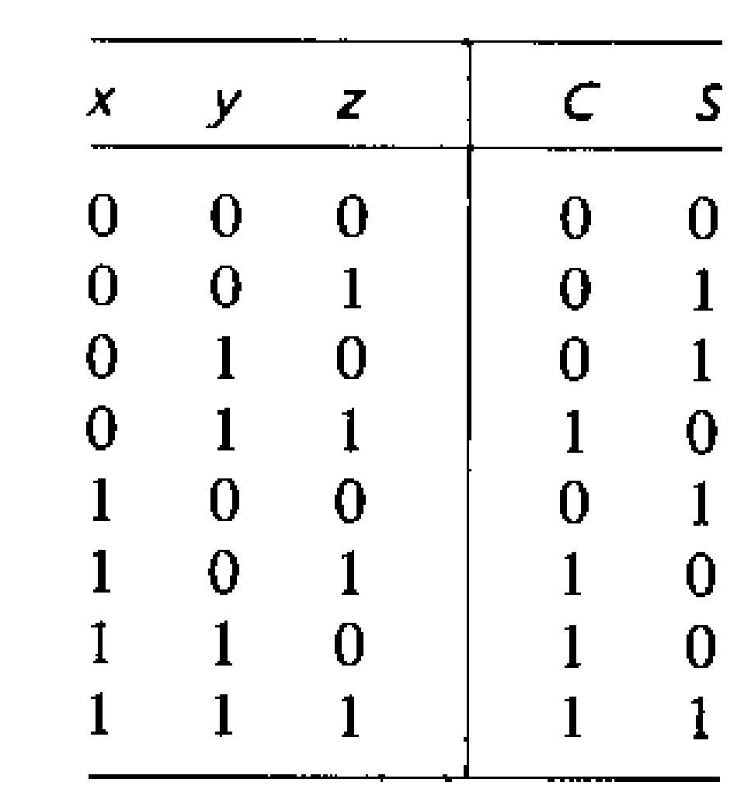
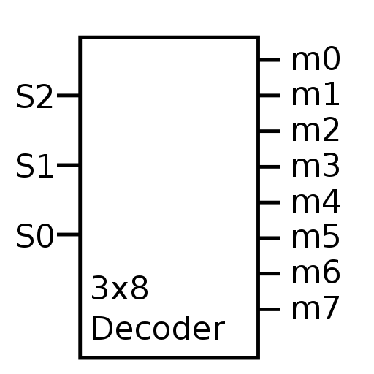
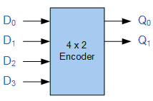
Solution:

